Slide 1
Sankey Chart
File created on: 4/25/21 4:09:05 PM GMT+05:30

Slide 2
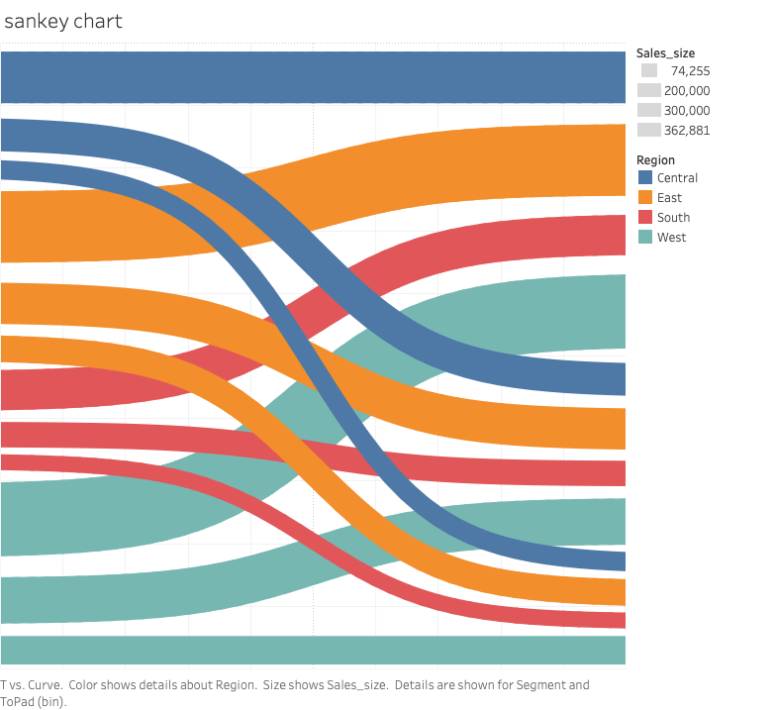

Slide 3
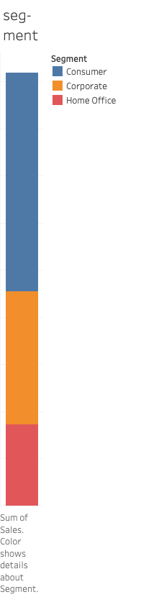

Slide 4
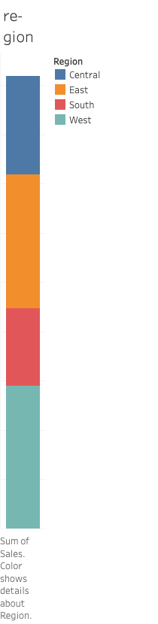

Slide 5
